Slide 1

Impression Management
The Art of Visibility
By
Dr. J. Balamurugan

Slide 2
Introduction
IMPRESSION MANAGEMENT is how to make a favorable impression, how to perceive others and evaluate others on the basis of
  Dress, make-up, hairstyle,
  Manner and general behavior,
  Body language.

Slide 3
Meaning
Behaving in ways so that others perceive us how we want to be perceived
It is a goal-directed conscious or unconscious attempt to influence the perceptions of other people about a person, object or event by regulating and controlling information in social interaction.
It is usually used synonymously with self-presentation

Slide 4
Definition
Erving Goffman – “When an individual appears in the presence of others, there will usually be some reason for him to mobilize his activity so that it will convey an impression to others which it is in his interests to convey.”
The process of representing yourself to others in a manner that creates a desired impression.
Impression Management is the goal- directed activity of controlling and regulating information in order to influence the impressions formed by an audience.

Slide 5
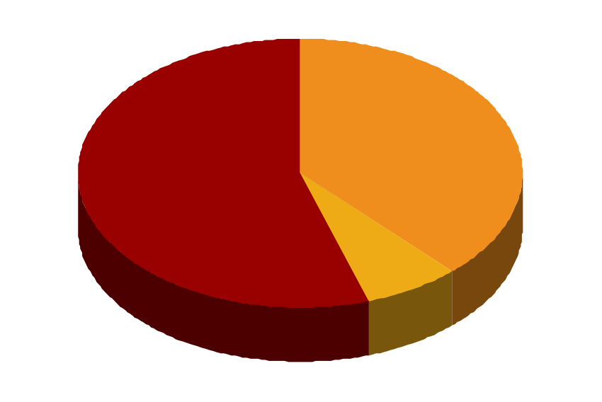
First impressions
38% tone, pitch & pace of your voice
55% appearance & body language
7% what you say

Slide 6
Two types of Impression Management
Constructive -- helps in the formation of self identity (for ex: dressing, appearance, makeup, hair style etc.)
Strategic -- helps in the attainment of some interpersonal goal (for ex: hand shaking, communication, body languages etc.)

Slide 7
Poor Impression Management
Four Motive of Poor Impression
  Avoidance
  Obtain
  Exit
  Power

Slide 8
Unfavorable Impression Management tactics
Decreasing Performance
Not Working to Potential
Withdrawing
Displaying a Bad Attitude
Broadcasting Limitations

Slide 9
How to do it - positively
Self descriptions (personal characteristics)
Conformity (agree with someone for approval)
Accounts (give excuses, justifications)
Apologies (admit and ask forgiveness)
Acclaiming (taking credit)
Flattery (saying nice things make yourself likable)
Favors (doing something nice – tit for tat?)

Slide 10
5 things you need to develop, which the world expected
Confidence
A personal brand (what do you want the world to think of you)
An ‘elevator pitch’
A winning image
Exposure skills/transferable experience

Slide 11
Confidence – how?
Know your stuff
Find opportunities to practice ‘presenting’ your stuff – get involved
ALWAYS be positive
NEVER be a one-track pony

Slide 12
Personal brand – how?
Who you are?????
What you are?????
What are your personal / professional ethics????

Slide 13
Elevator pitch – how?
Do
  Speak!
  Make small talk
  Ask open questions
Don’t
  Ignore him/her
  Talk about the weather
  Get too personal

Slide 14
A winning image – how?
Appropriate
Balanced
Professional – not powerful
Modern
Clean

Slide 15
Exposure skills – how?
Interact
Get involved
Ask questions
Volunteer
Don’t wait to be asked
Don’t sit back

Slide 16
Few Tips On How To Improve
Impression Management
Set goals.
Commit to the change.
Dress appropriately.
Learn how to properly shake hands.
Keep your body language open.

Slide 17
Impression Management Tactics
Behavioral
Matching
The target of perception matches
his or her behavior to that of the
perceiver.
A subordinate tries to imitate her boss’s
behavior by being modest and soft-spoken
because her boss is modest and soft-spoken.
Self-
Promotion
The target tries to present herself
or himself in as positive a light as
possible.
A worker reminds his boss about his past
accomplishments and associates with co-
workers who are evaluated highly.
Conforming
to Situational
Norms
The target follows agreed-upon
rules for behavior in the
organization.
A worker stays late every night even if she has
completed all of her assignments because
staying late is one of the norms of her
organization.
Appreciating
or Flattering
Others
The target compliments the per-
ceiver. This tactic works best when
flattery is not extreme and when it
involves a dimension important
to the perceiver.
A coworker compliments a manager on his
excellent handling of a troublesome employee.
Being
Consistent
The target’s beliefs and behaviors
are consistent. There is agreement
between the target’s verbal and
nonverbal behaviors.
A subordinate delivering a message to his boss
looks the boss straight in the eye and has a
sincere expression on his face.

Slide 18
Thank you

